Slide 1

COURSE: INTRODUCTION TO ELECTRICAL AND ELECTRONICS ENGINEERING
Group - 12
THE
ECO-SENSE-(AI)NATOR
"An Integrated IoT System for Sustainable Tourism and Wildlife Conservation"
22AIE114 TERM PROJECT Final EVALUATION​
1
8/9/2023

Slide 2


INTRODUCTION
This project aims to revolutionize tourism and wildlife conservation by developing a comprehensive system that integrates sensor technologies, wireless communication, and environmental monitoring. By combining a device carried by tourists in remote areas with environmental sensor nodes, the project provides real-time information about wildlife and environmental conditions, aiding tourists in navigation while contributing to wildlife conservation efforts. With the potential to detect animal movements, population densities, tree cutting, earthquakes, and forest fires, this system can empower informed decision-making, support responsible consumption and production, and contribute to the monitoring and preservation of biodiversity, thereby addressing key aspects of the Sustainable Development Goals.
3
8/9/2023
22AIE114 TERM PROJECT Final EVALUATION​

Slide 3





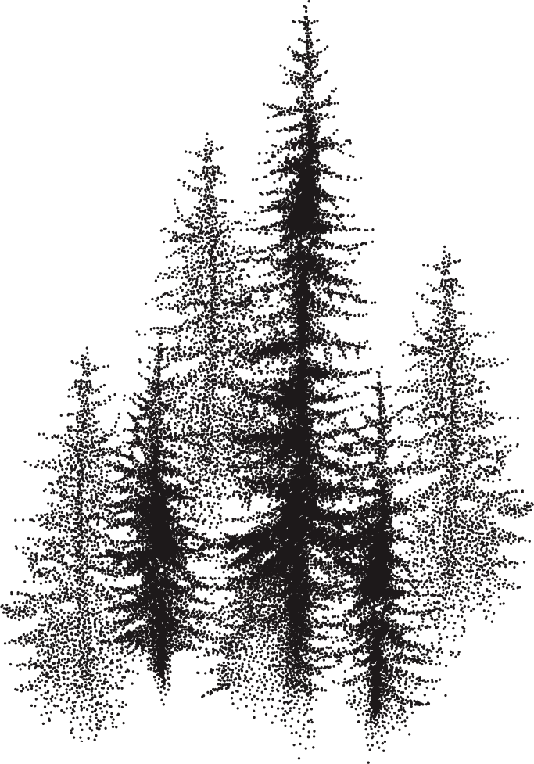



22AIE114 TERM PROJECT Final EVALUATION​
OUr Team
Contribution
%Contribution
(Sum = 100%)
Coding arduino
project design
Coding[python]
Hardware
report making
Report making
hardware design
hardware design
report making
coding [python]
30%
20%
25%
30%
Ch. Nikhilesh Krishna [015] -
Sujay Bharath Raj [027] -
N. Kireeti Sai Bharadwaj [037] -
Avishek Rauniyar [062] -
8/9/2023
2

Slide 4

Challenges
Insufficient wildlife data: Wildlife conservation efforts require accurate and up-to-date data on animal movements, population densities, and other critical factors. However, obtaining such data in remote areas can be challenging, leading to gaps in understanding and hindering effective conservation strategies.
Tourist navigation in remote areas: Tourists visiting remote areas often face difficulties in navigating unfamiliar terrains, which can impact their safety and overall experience. Lack of proper guidance systems can limit their ability to explore these areas while minimizing their impact on the environment and wildlife.
Environmental Monitoring: Monitoring environmental conditions, such as tree cutting, and forest fires, is crucial for effective conservation and disaster management. Forest fires, in particular, pose a significant threat to ecosystems and biodiversity. According to the Global Forest Resources Assessment 2020, an estimated 10 million hectares of forest are lost to fires annually. By integrating smoke sensors into the project, it enhances environmental monitoring capabilities, enabling early detection and timely response to forest fires.
4
8/9/2023
22AIE114 TERM PROJECT Final EVALUATION​

Slide 5
Relevant Data
According to the International Union for Conservation of Nature (IUCN), inadequate data on wildlife populations hinders conservation efforts, with many species lacking accurate population assessments.
In KSA, road accidents involving camels are a prevalent issue. According to the Saudi Arabian Traffic Department, these accidents cause numerous disabilities and fatalities each year, affecting both human lives and camel populations.
The impact of inadequate tourist navigation systems can be seen in incidents of tourists getting lost, stranded, or unintentionally disturbing sensitive habitats or wildlife due to the lack of proper guidance and information.
Forest fires pose a significant threat to ecosystems worldwide. According to the World Wildlife Fund (WWF), an estimated 8.8 million hectares of forest are lost annually due to fires, leading to habitat destruction and loss of biodiversity.
5
8/9/2023
22AIE114 TERM PROJECT Final EVALUATION​

Slide 6





SDG GOALS
SDG 12: Responsible Consumption and Production - By monitoring wildlife populations and providing real-time information about environmental conditions, the project enables informed decision-making and contributes to the sustainable use of natural resources.
SDG 13: Climate Action - By detecting wildlife movements, population densities, and environmental factors, the project enhances understanding of ecosystems and their dynamics, which can inform conservation strategies in the face of climate change and its impacts.
SDG 15: Life on Land - The project supports the monitoring and preservation of biodiversity by detecting wildlife, contributing to the conservation of endangered species and habitats, and promoting sustainable land management practices.
6
22AIE114 TERM PROJECT Final EVALUATION​
8/9/2023

Slide 7



SDG GOALS
SDG 9: Industry, Innovation, and Infrastructure - The project utilizes sensor technologies, wireless communication, and AI models to create an innovative infrastructure for wildlife monitoring, tourist navigation, and environmental conservation.
SDG 11: Sustainable Cities and Communities - The project contributes to the development of sustainable tourism practices by promoting responsible navigation in remote areas and ensuring the safety and security of tourists.
SDG 17: Partnerships for the Goals - The project can foster partnerships between various stakeholders, such as government entities, conservation organizations, and tourism industry players, to collectively work towards sustainable tourism, wildlife conservation, and environmental management.
7
22AIE114 TERM PROJECT Final EVALUATION​
8/9/2023

Slide 8

Literature Review
The paper "Real Time IoT Based Camel-Vehicle Collision Avoidance System for KSA" presented at the 2020 3rd International Conference on Computer Applications & Information Security (ICCAIS) in Riyadh, Saudi Arabia, introduces an innovative system designed to prevent collisions between vehicles and camels in the Kingdom of Saudi Arabia (KSA) using the Internet of Things (IoT) technology.
The paper titled "Object Detection and Tracking Using Yolo" was presented at the 2021 Third International Conference on Inventive Research in Computing Applications (ICIRCA) in Coimbatore, India. The paper explores the utilization of the YOLO (You Only Look Once) algorithm for object detection and tracking.
8
8/9/2023
22AIE114 TERM PROJECT Final EVALUATION​

Slide 9

The paper titled "An Integrated Approach to the Regression Problem in Forest Fires Detection" was presented at the 2020 Systems of Signals Generating and Processing in the Field of On-Board Communications conference in Moscow, Russia. The paper focuses on an integrated methodology for addressing the regression problem in the detection of forest fires.
The paper titled "Single-Target Real-Time Passive WiFi Tracking," was published in the IEEE Transactions on Mobile Computing, Volume 22, Issue 6, on June 1, 2023. The paper presents a novel approach for real-time passive tracking of a single target using WiFi technology.
The paper titled "Advanced Wild Animal Detection and Alert System using YOLO V5 Model," authored by C. S. Madhumathi, V. Naveen, N. Akshay, M. S. Kumar, and M. M. Aslam, was presented at the 2023 7th International Conference on Trends in Electronics and Informatics (ICOEI) in Tirunelveli, India. The paper introduces an innovative system for the advanced detection of wild animals using the YOLO V5 model, coupled with an alert mechanism.
22AIE114 TERM PROJECT Final EVALUATION​
9
8/9/2023
22AIE114 TERM PROJECT Final EVALUATION​
8/9/2023

Slide 10
The paper titled "Research Guide for ML-based Smart Tourist System," was presented at the 2022 International Interdisciplinary Humanitarian Conference for Sustainability (IIHC) in Bengaluru, India. The paper serves as a guide for the development of a smart tourist system based on machine learning (ML) techniques.
The paper titled "Wild Animal Detection using a Machine Learning Approach and Alerting using LoRa Communication,"was presented at the 2022 International Conference on Smart Generation Computing, Communication, and Networking (SMART GENCON) in Bangalore, India. The paper introduces a method for detecting wild animals using a machine learning approach, coupled with alerting through LoRa (Long Range) communication.
The paper titled "Design of Smoke Detection and Alarm System Based on LoRa," was presented at the 2020 Chinese Automation Congress (CAC) in Shanghai, China. The paper introduces a smoke detection and alarm system designed using LoRa (Long Range) communication technology.
10
8/9/2023
22AIE114 TERM PROJECT Final EVALUATION​
9
8/9/2023
22AIE114 TERM PROJECT Final EVALUATION​

Slide 11
The paper titled "Cloud-Based Surveillance using ESP32 CAM," was presented at the 2021 International Conference on Intelligent Technology, System, and Service for the Internet of Everything (ITSS-IoE) in Sana'a, Yemen. The paper introduces a surveillance system that leverages the ESP32 CAM module for cloud-based monitoring and management.
The paper titled "Forest Fire Detection and Prediction – Survey," was presented at the 2022 International Conference on Inventive Computation Technologies (ICICT) in Nepal. The paper provides a comprehensive survey of forest fire detection and prediction methods.
The paper titled "IoT System for Forest Monitoring," was presented at the 2019 42nd International Conference on Telecommunications and Signal Processing (TSP) in Budapest, Hungary. The paper introduces an Internet of Things (IoT) system designed for the purpose of forest monitoring.
11
8/9/2023
22AIE114 TERM PROJECT Final EVALUATION​
9
8/9/2023
22AIE114 TERM PROJECT Final EVALUATION​

Slide 12
The paper titled "Creating Alert Messages Based on Wild Animal Activity Detection Using Hybrid Deep Neural Networks," is published in the IEEE Access journal, Volume 11, pages 67308-67321, in the year 2023. The paper presents a method for generating alert messages by leveraging a hybrid deep neural network approach for detecting wild animal activity.
The research titled "Wild Animal Detection and Recognition from Aerial Videos Using Computer Vision Technique" was conducted by The World Academy of Research in Science and Engineering (WARSE). The findings of this study were published in the "International Journal of Emerging Trends in Engineering Research" in 2019. The research focuses on the application of computer vision techniques for the detection and recognition of wild animals in aerial videos.
The research titled "Real-Time Object Detection with YOLO" was published in the "International Journal of Engineering and Advanced Technology" (IJEAT) in February 2019. The research focuses on real-time object detection using the YOLO (You Only Look Once) algorithm.
12
8/9/2023
22AIE114 TERM PROJECT Final EVALUATION​
9
8/9/2023
22AIE114 TERM PROJECT Final EVALUATION​

Slide 13
The research titled "Dynamic and Chromatic Analysis for Fire Detection and Alarm Raising Using Real-Time Video Analysis" was presented at the 3rd International Conference on Computational Vision and Bio-Inspired Computing held in Cham in 2019. The research focuses on using real-time video analysis techniques for fire detection and alarm generation, incorporating dynamic and chromatic analysis methods.
The review article titled "Integrated Animal Monitoring System with Animal Detection and Classification Capabilities: A Review on Image Modality, Techniques, Applications, and Challenges." This review was published in the journal "Artificial Intelligence Review," volume 52.
The research article authored by Raji C.G, Fathima Safa, Jishana P, and Mohammed Adhil in 2023 is titled "Early Warning System from Threat of Wild Animals using Digital Image Processing." This work was presented at the 2023 3rd International Conference on Smart Data Intelligence (ICSMDI), with the proceedings covering pages 322-326.
13
8/9/2023
22AIE114 TERM PROJECT Final EVALUATION​
9
8/9/2023
22AIE114 TERM PROJECT Final EVALUATION​

Slide 14



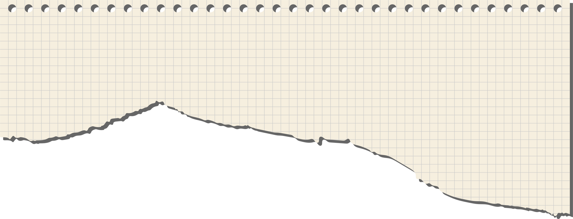


8/9/2023
Methodology
The project uses a combination of sensor technologies, data processing, wireless communication, and AI models to address the challenges of wildlife conservation, tourist navigation, and environmental monitoring. Key steps include defining objectives and data requirements, sensor selection and integration, preparing training data for AI models, developing and training AI models, integrating them with sensors, implementing wireless communication, and testing the system for accuracy and effectiveness. This approach enables real-time data analysis and informed decision-making to support responsible consumption, climate action, and life on land, contributing to the Sustainable Development Goals.
14
22AIE114 TERM PROJECT Final EVALUATION​

Slide 15

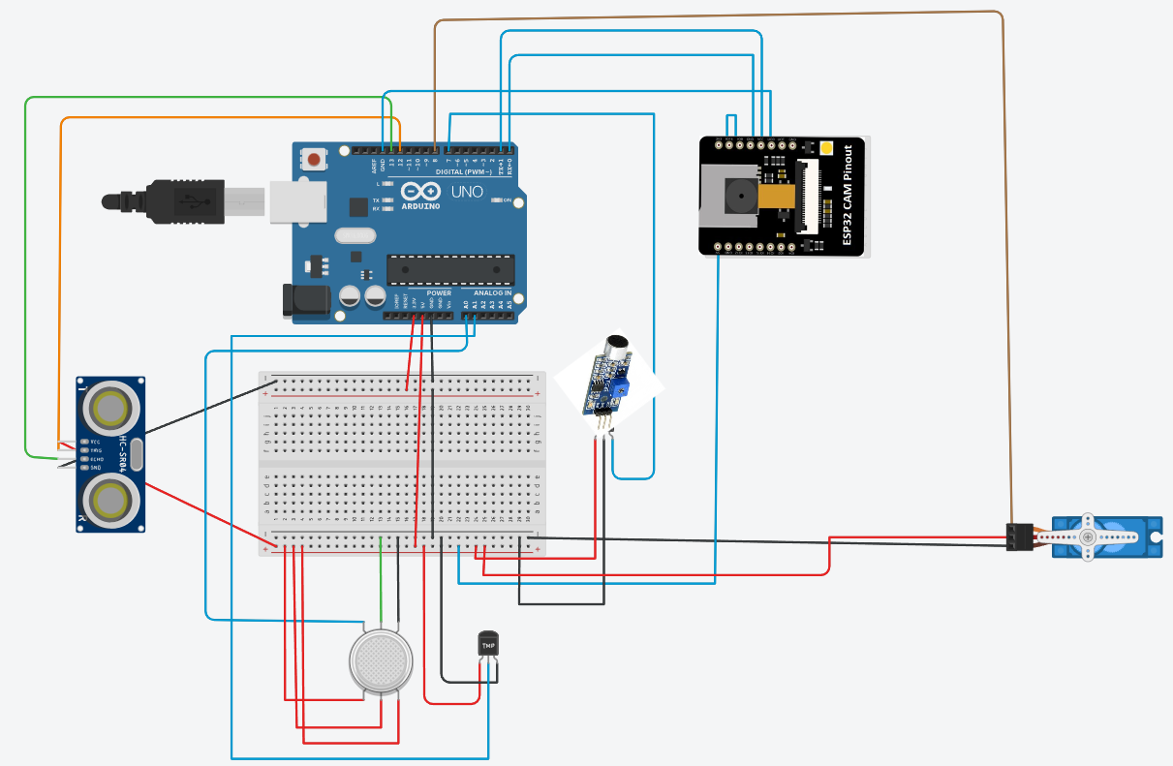

Proposed Model
15
8/9/2023
22AIE114 TERM PROJECT Final EVALUATION​

Slide 16

ELECTRICAL
1. Arduino UNO - 1,140/-
2. MQ 2 Gas/Smoke Detector - 225/-
3. LM35 temperature sensor - 190/-
4. ESP32 CAM Module - 900/-
5. CZN-15E sound sensor - 200/-
6. Servo motor - 240/-
7. Ultrasonic module - 200/-
8. Resistors - 60/-
9. Bread board - 100/-
10. Connecting wires - 185/-
11. FT232RL - 250/-
16
12
8/9/2023
22AIE114 TERM PROJECT Final EVALUATION​

Slide 17
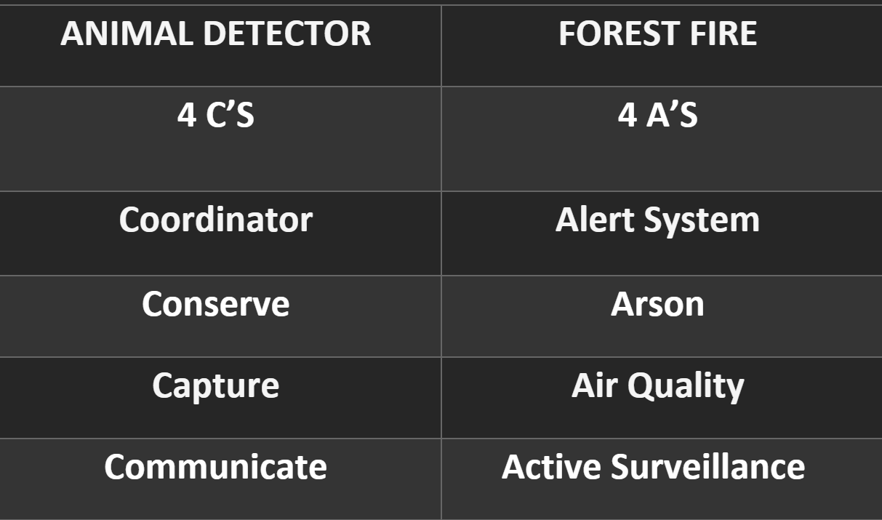
17
8/9/2023
22AIE114 TERM PROJECT Final EVALUATION​

Slide 18
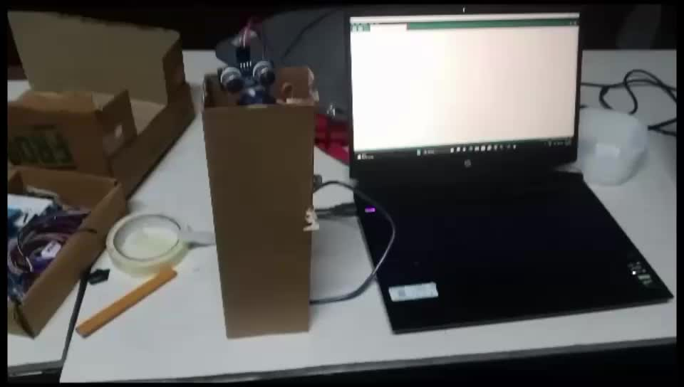
SIMULATION/HARDWARE
18
8/9/2023
22AIE114 TERM PROJECT Final EVALUATION​

Slide 19

8/9/2023
22AIE114 TERM PROJECT Final EVALUATION​
RESULTS (AFTERMATH)
Illegal Activity Detection: The system can alert authorities to potential poaching or other illegal activities in protected areas, helping with wildlife law enforcement using camera for survilience.
Adaptive Management: The information provided by the system can inform adaptive management strategies, allowing for timely adjustments to conservation efforts.
Environmental Impact: By tracking the movement and behavior of wildlife, the system can assess the impact of human activities on their habitats.
The implementation of this project leads to enhanced tourism experiences, characterized by both efficiency and security. Through the establishment of comprehensive surveillance measures, tourists are able to explore their surroundings without posing any threats to the environment or wildlife, thereby enjoying a sense of peace and tranquility throughout their journey.
19
22AIE114 TERM PROJECT PHASE 1 EVALUATION​

Slide 20
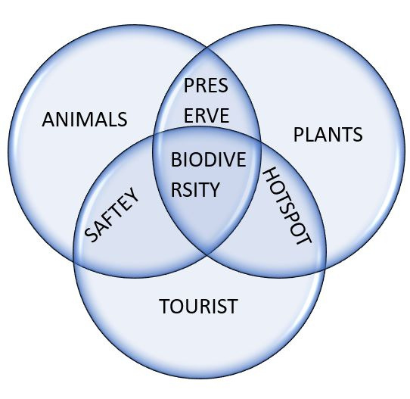
8/9/2023
20
22AIE114 TERM PROJECT Final EVALUATION​

Slide 21
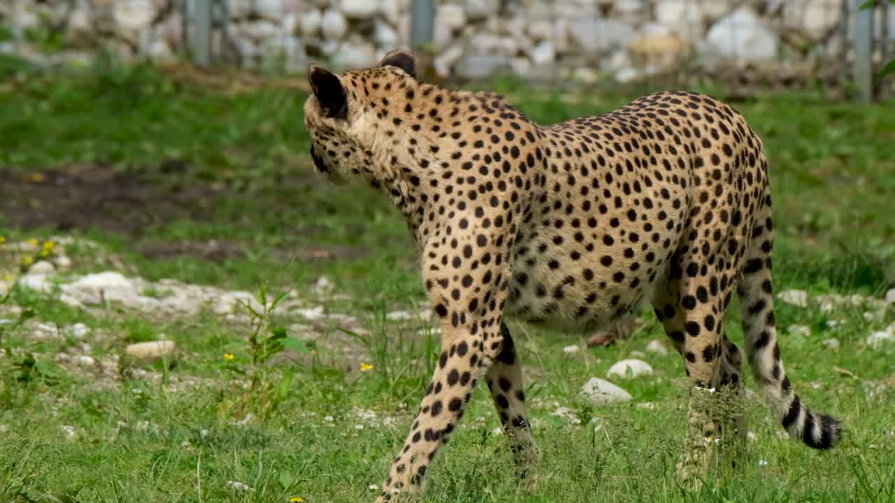
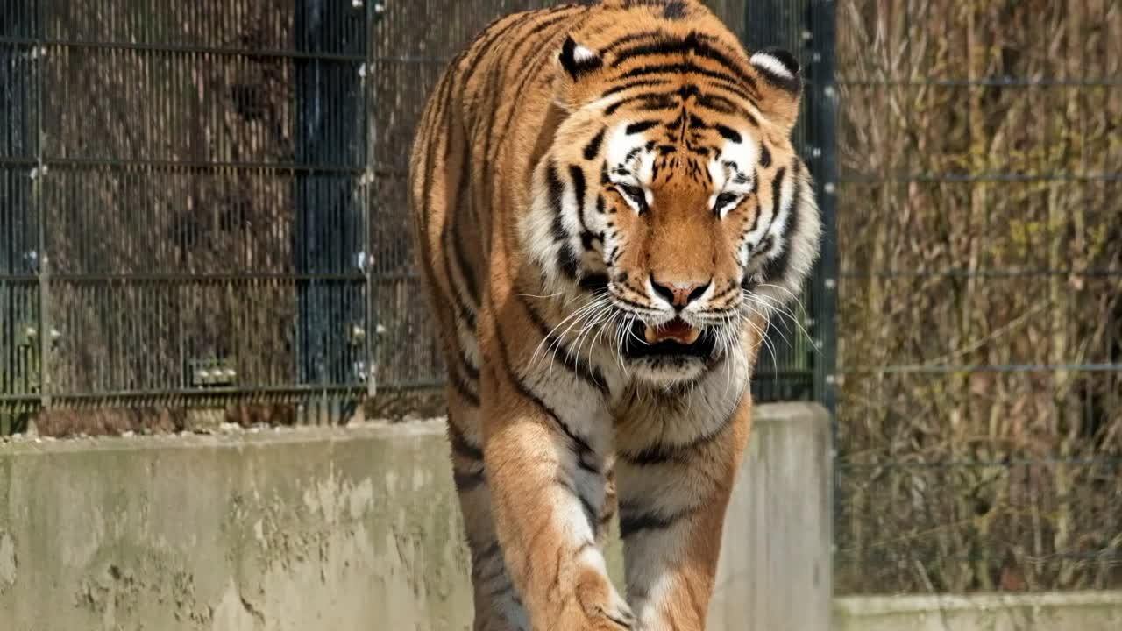
8/9/2023
CONCLUSION
In conclusion, this project presents a comprehensive system that combines sensor technologies, wireless communication, and AI models to revolutionize tourism, wildlife conservation, and environmental monitoring. By integrating devices carried by tourists with environmental sensor nodes, real-time data on wildlife movements, population densities, tree cutting, earthquakes, and forest fires can be collected and analyzed. The use of AI models enhances data processing and enables informed decision-making. This project contributes to the Sustainable Development Goals, promoting responsible consumption and production, climate action, and the preservation of life on land. Through its innovative approach, it has the potential to transform the way we experience tourism while fostering a greater understanding and conservation of our natural resources and endangered species.
22AIE114 TERM PROJECT Final EVALUATION​
21

Slide 22

REFERENCES
W. Saad and A. S. Alsayyari, "Real Time IoT Based Camel-Vehicle Collision Avoidance System for KSA," 2020 3rd International Conference on Computer Applications & Information Security (ICCAIS), Riyadh, Saudi Arabia, 2020, pp. 1-4, doi: 10.1109/ICCAIS48893.2020.9096714
N. M. Krishna, R. Y. Reddy, M. S. C. Reddy, K. P. Madhav and G. Sudham, "Object Detection and Tracking Using Yolo," 2021 Third International Conference on Inventive Research in Computing Applications (ICIRCA), Coimbatore, India, 2021, pp. 1-7, doi: 10.1109/ICIRCA51532.2021.9544598.
22AIE114 TERM PROJECT Final EVALUATION​
22
8/9/2023

Slide 23
I. S. Sineva and M. D. Molovtsev, "An Integrated Approach to the Regression Problem in Forest Fires Detection," 2020 Systems of Signals Generating and Processing in the Field of on Board Communications, Moscow, Russia, 2020, pp. 1-4, doi: 10.1109/IEEECONF48371.2020.9078645.
Z. Wang, J. A. Zhang, M. Xu and Y. J. Guo, "Single-Target Real-Time Passive WiFi Tracking," in IEEE Transactions on Mobile Computing, vol. 22, no. 6, pp. 3724-3742, 1 June 2023, doi: 10.1109/TMC.2022.3141115.
C. S. Madhumathi, V. Naveen, N. Akshay, M. S. Kumar and M. M. Aslam, "Advanced Wild Animal Detection and Alert System using YOLO V5 Model," 2023 7th International Conference on Trends in Electronics and Informatics (ICOEI), Tirunelveli, India, 2023, pp. 365-371, doi: 10.1109/ICOEI56765.2023.10126065.
23
19
8/9/2023
22AIE114 TERM PROJECT Final EVALUATION​

Slide 24
A. Gehlot and R. Singh, "Research Guide for ML based Smart Tourist System," 2022 International Interdisciplinary Humanitarian Conference for Sustainability (IIHC), Bengaluru, India, 2022, pp. 1427-1434, doi: 10.1109/IIHC55949.2022.10059630.
G. Bandari, P. L. Nirmala Devi and P. Srividya, "Wild Animal Detection using a Machine Learning Approach and Alerting using LoRa Communication," 2022 International Conference on Smart Generation Computing, Communication and Networking (SMART GENCON), Bangalore, India, 2022, pp. 1-5, doi: 10.1109/SMARTGENCON56628.2022.10083577.
Z. Li, J. Liu, C. Guo, S. Li, L. Li and L. Xu, "Design of Smoke Detection and Alarm System Based on LoRa," 2020 Chinese Automation Congress (CAC), Shanghai, China, 2020, pp. 5086-5090, doi: 10.1109/CAC51589.2020.9326322.
A. Kaur, A. Jadli, A. Sadhu, S. Goyal, A. Mehra and Rahul, "Cloud Based Surveillance using ESP32 CAM," 2021 International Conference on Intelligent Technology, System and Service for Internet of Everything (ITSS-IoE), Sana'a, Yemen, 2021, pp. 1-5, doi: 10.1109/ITSS-IoE53029.2021.9615334.
24
20
8/9/2023
22AIE114 TERM PROJECT Final EVALUATION​

Slide 25
P. Thirumal and L. Shylu Dafni Agnus, "Forest Fire Detection and Prediction – Survey," 2022 International Conference on Inventive Computation Technologies (ICICT), Nepal, 2022, pp. 1295-1302, doi: 10.1109/ICICT54344.2022.9850518.
A. -E. Marcu, G. Suciu, E. Olteanu, D. Miu, A. Drosu and I. Marcu, "IoT System for Forest Monitoring," 2019 42nd International Conference on Telecommunications and Signal Processing (TSP), Budapest, Hungary, 2019, pp. 629-632, doi: 10.1109/TSP.2019.8768835.
N. Sundaram, S. Divya Meena. (2023) Integrated animal monitoring system with animal detection and classification capabilities: a review on image modality, techniques, applications, and challenges. Artificial Intelligence Review 52.
Raji C.G, Fathima Safa, Jishana P, Mohammed Adhil. (2023) Early Warning System from Threat of Wild Animals using Digital Image Processing. 2023 3rd International Conference on Smart Data Intelligence (ICSMDI), pages 322-326.
22AIE114 TERM PROJECT Final EVALUATION​
25
8/9/2023

Slide 26
REFERENCES
AMRITA PAPERS
B. Natarajan, R. Elakkiya, R. Bhuvaneswari, K. Saleem, D. Chaudhary and S. H. Samsudeen, "Creating Alert Messages Based on Wild Animal Activity Detection Using Hybrid Deep Neural Networks," in IEEE Access, vol. 11, pp. 67308-67321, 2023, doi: 10.1109/ACCESS.2023.3289586.
2. WARSE The World Academy, and Engineering. “Wild Animal Detection and Recognition from Aerial Videos Using Computer Vision Technique.” International Journal of Emerging Trends in Engineering Research (2019): n. pag. Web.
22AIE114 TERM PROJECT Final EVALUATION​
26
8/9/2023

Slide 27
REFERENCES
AMRITA PAPERS
3. Geethapriya. S, N. Duraimurugan, SP. Chokkalingam “Real-Time Object Detection with Yolo”, International Journal of Engineering and Advanced Technology (IJEAT) ISSN: 2249 -8958, Volume-8, Issue-3S, February 2019
4. P. S. Srishilesh, Parameswaran, L., Tharagesh, R. S. Sanjay, Dr. Senthil Kumar T., and Sridhar, P., “Dynamic and Chromatic Analysis for Fire Detection and Alarm Raising Using Real-Time Video Analysis”, in Proceedings of 3rd International Conference On Computational Vision and Bio Inspired Computing, Cham, 2019
22AIE114 TERM PROJECT Final EVALUATION​
27
8/9/2023

Slide 28
Thank you!
8/9/2023
22AIE114 TERM PROJECT Final EVALUATION​
28

